Slide 1
OPPURTUNITY HUB
TEAM MEMBERS:
RASHMIKA K R 21ALR076
RITHIK CHANDRASEKAR 21ALR081
PADMAPRIYA R 21ALR063

Slide 2
INTRODUCTION:
Opportunity Hub is a premier web development project designed to revolutionize the job market by serving as a dynamic and interactive platform for job seekers and employers. This innovative portal aims to bridge the gap between talent and opportunity, creating a seamless experience for both parties.
For Job Seekers:
Opportunity Hub offers a comprehensive and user-friendly interface where job seekers can showcase their skills, qualifications, and field specialities. By creating detailed profiles, job seekers can highlight their expertise, making it easier for potential employers to find and evaluate their capabilities. The platform provides robust search functionalities, allowing job seekers to explore various job postings that match their skill sets and career aspirations.
For Employers:
Employers can leverage Opportunity Hub to post job vacancies and search for potential candidates that fit their organizational needs. The portal’s sophisticated filtering and matching algorithms ensure that employers can efficiently identify and connect with the most suitable candidates. By accessing a diverse pool of talent, employers can streamline their recruitment process and enhance their workforce with highly qualified professionals.

Slide 3
Key Features:
• Profile Management: Detailed profiles for both job seekers and employers, ensuring clarity and visibility.
• Advanced Search: Powerful search and filtering options to match job seekers with relevant job postings and vice versa.
• Direct Communication: Integrated messaging system for seamless interaction between job seekers and employers.
• Job Alerts: Personalized notifications for job seekers about new opportunities that match their profiles.
• Analytics: Insightful data and analytics to help employers make informed hiring decisions.

Slide 4
REQUIREMENTS:
Front-End Programming
React: React is the cornerstone of our front-end development for Opportunity Hub. This popular JavaScript library allows us to build a dynamic and responsive user interface with a component-based architecture. React enables the creation of reusable UI components that efficiently update in response to data changes. By leveraging the virtual DOM, React ensures optimal performance, even in complex web applications, enhancing the user experience for both job seekers and employers.
CSS (Cascading Style Sheets): CSS is integral to defining the visual appearance and layout of Opportunity Hub. It allows our developers to apply consistent styles, such as colours, fonts, spacing, and positioning, across all HTML elements. This results in a visually appealing and uniform interface, ensuring a pleasant and engaging experience for users as they navigate the portal.
JavaScript: JavaScript brings interactivity and dynamic behaviour to the front end of Opportunity Hub. It enables developers to manipulate HTML and CSS, handle user interactions, validate forms, and perform calculations. JavaScript is also crucial for making asynchronous requests to the server, facilitating smooth and responsive user experiences.

Slide 5
Back-End Programming
Node.js: Node.js forms the backbone of our back-end development. This JavaScript runtime environment allows us to execute server-side code and build scalable network applications. Node.js is known for its event-driven architecture and non-blocking I/O operations, making it ideal for handling the real-time interactions and data processing required by Opportunity Hub.
Express: Express is a lightweight and flexible Node.js web application framework that we use to build our server-side logic. It simplifies the creation of robust APIs and web servers, providing a streamlined approach to managing routes, middleware, and request handling. Express plays a crucial role in facilitating communication between the front-end and back end components of our application.
MongoDB: MongoDB is our choice for database management, fitting seamlessly into the MERN stack. As a NoSQL database, MongoDB offers flexibility in storing and querying data in a JSON-like format. This allows for efficient handling of large volumes of unstructured data, ensuring quick retrieval and storage of job postings, user profiles, and other critical information. MongoDB’s scalability and performance make it an excellent choice for supporting the dynamic data needs of Opportunity Hub.

Slide 6
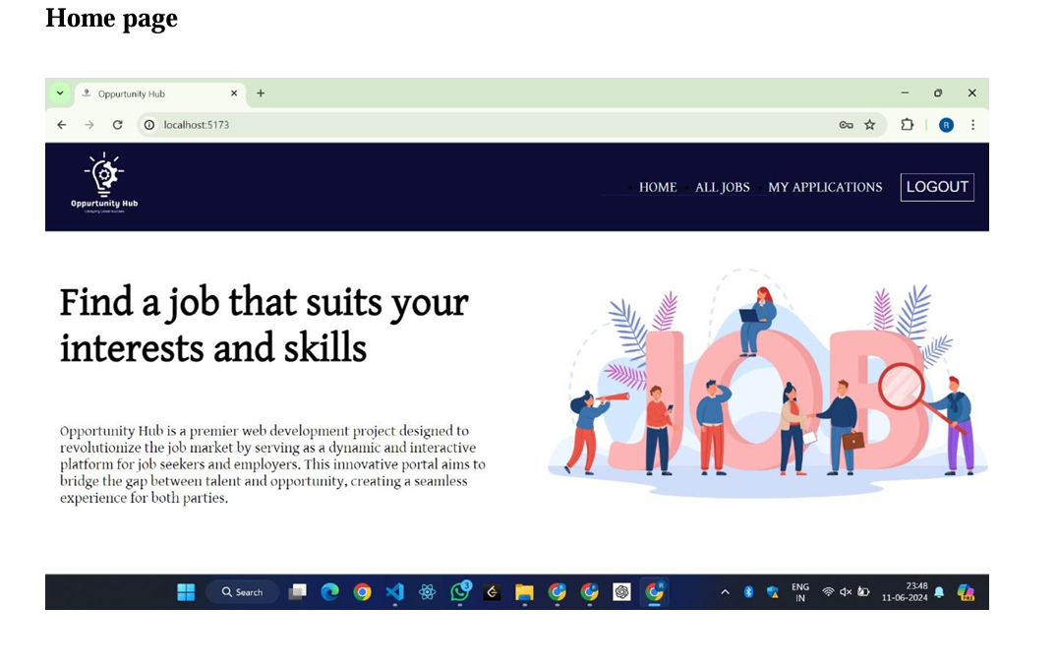

Slide 7
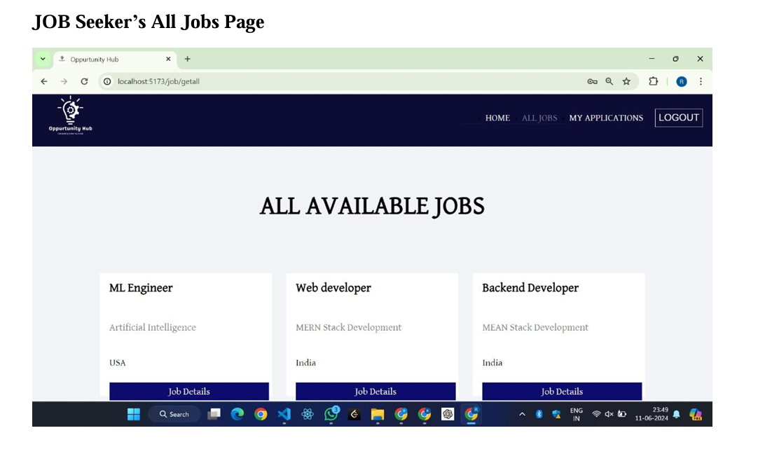

Slide 8
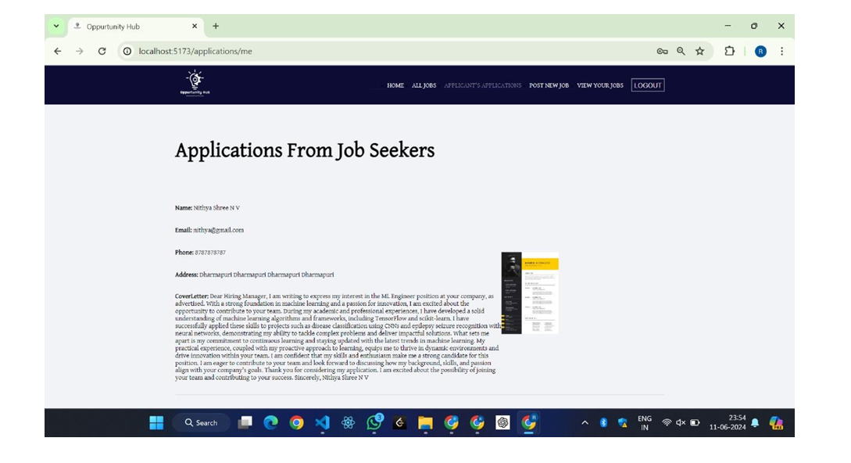

Slide 9
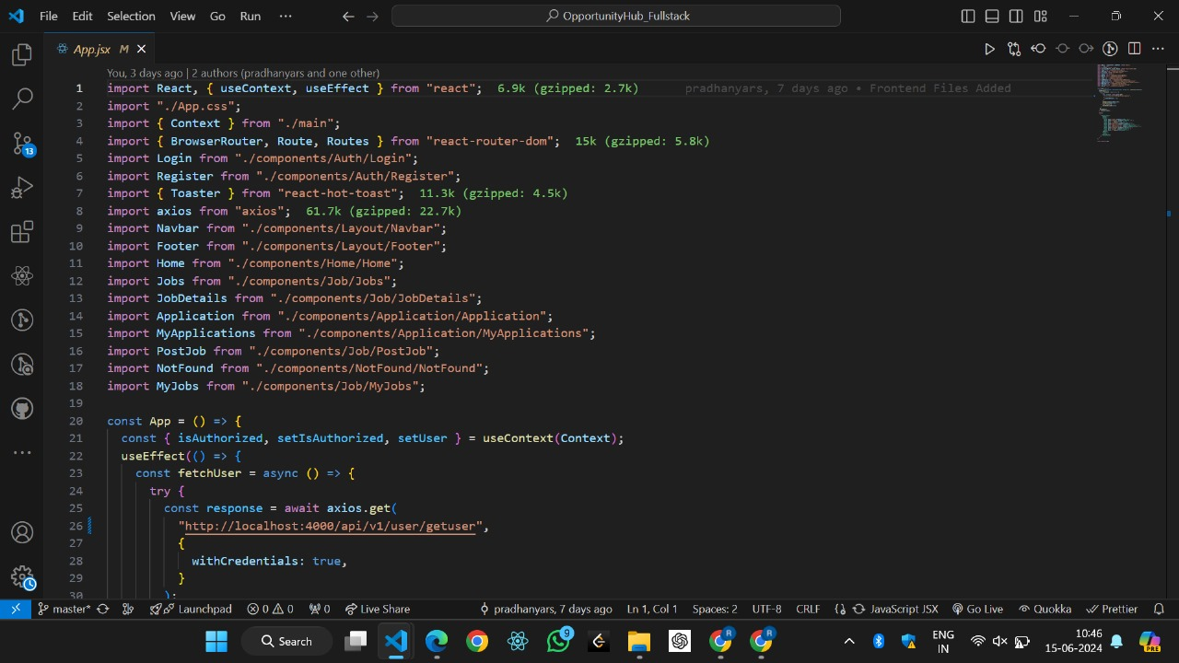
SAMPLE CODING:

Slide 10
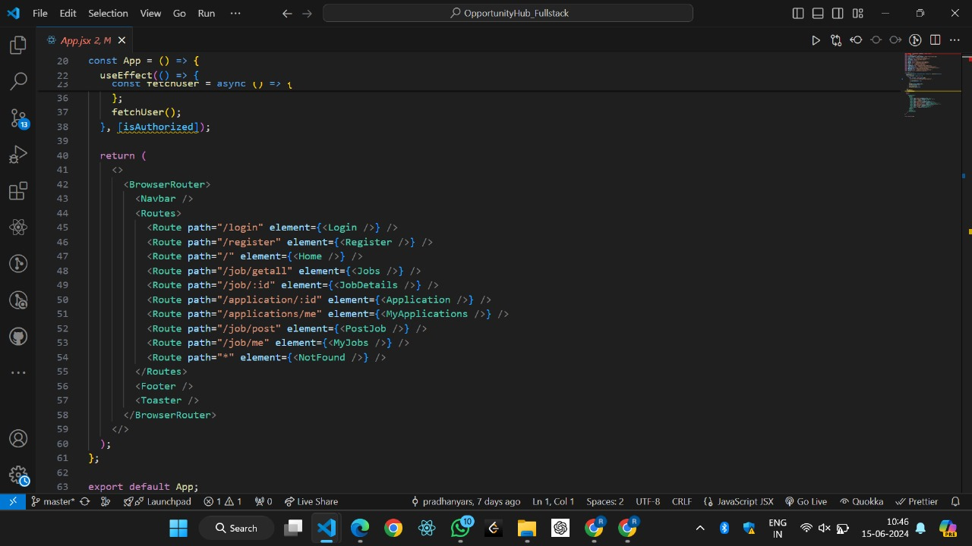

Slide 11
CONCLUSION:
Opportunity Hub stands as a testament to the innovative potential of web development, utilizing the robust MERN stack—MongoDB, Express, React, and Node.js—to create a dynamic and efficient job seek portal. By seamlessly integrating front-end and back-end technologies, Opportunity Hub offers a powerful platform that effectively bridges the gap between job seekers and employers.
For job seekers, the platform provides a user-friendly interface to showcase their skills and find relevant job opportunities, while employers benefit from advanced search and filtering capabilities to discover and connect with qualified candidates. Enhanced by real-time notifications, robust authentication, and comprehensive data analytics, Opportunity Hub ensures a secure, responsive, and engaging user experience.
In essence, Opportunity Hub is more than just a job portal; it is a comprehensive ecosystem designed to foster meaningful professional connections and streamline the recruitment process. By leveraging modern web technologies, Opportunity Hub is poised to transform the employment landscape, making it easier for talent and opportunities to find each other

